Slide 1
Checkpoint Introduction to DATABASE
Réalisée par Boughattas Amel

Slide 2
Outline
Presentation & functionalities :
MYSQL
PostgresSQL
SQL SERVER
Comparison between the three RDBMS
Conclusion

Slide 3
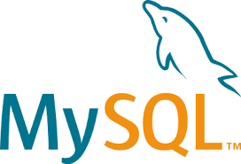
MYSQL
It is the world’s most commonly used RDBMS
It is named after developer Michael Widenius; daughter, MY
Its source code is available under the terms of the GNU General Public License.
MySQL was owned and sponsored by a single for-profit firm, the Swedish company
MySQL AB, now owned by Oracle Corporation
MySQL is used in high-profile, large-scale World Wide Web products, including
Wikipedia, Google, Facebook and Twitter.
Originally developed by Michael Widenius and David Axmark in 1994
First release on 23rd of May 1995, MySQL server 5.5 was released in December 2010

Slide 4
It is the most popular choice of database for use in web applications
It is a central component of the widely used LAMP open source web application software stack (LAMP: Linux, Apache, MySQL, Perl/PHP/Python)
MySQL is written in C and C++
It works on many different system platforms, including Linux, Mac OS X, Solaris, etc.
Some programming languages include libraries for accessing MySQL databases. These include MySQL Connector/Net for integration with Microsoft’s Visual Studio and JDBC driver for Java
MySQL has no GUI tools to administer the databases or manage the data contained
Official MySQL Workbench enables users to graphically administer MySQL databases and visually design database structures
MySQL Workbench allows the users to manage the following:
Database design & modeling
SQL Development
Database Administration

Slide 5
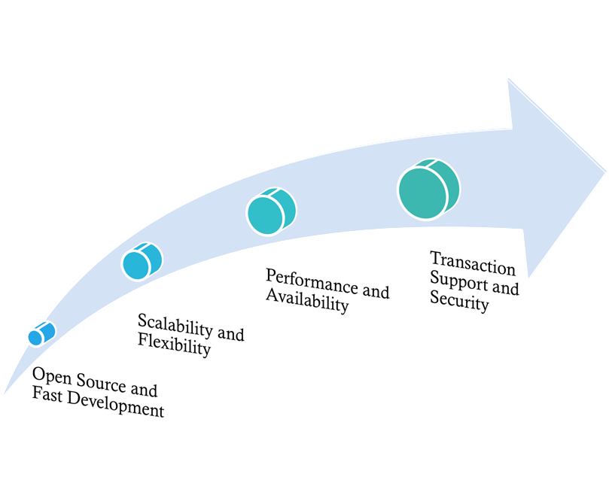
MYSQL has proven itself to be fast, reliable and cost effective to other competitors such as MS
SQL Server and Oracle
It is free and developers can amend its code to suit their requirements, which makes MYSQL
highly customizable

Slide 6
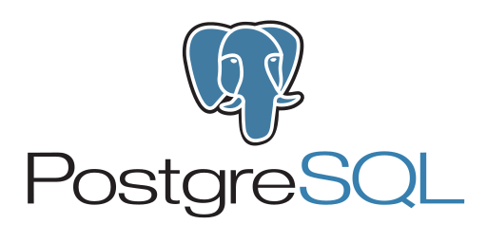
PostgreSQL
The PostgreSQL project started in 1986 at Berkeley Computer Science Department, University of California.
The project was originally named POSTGRES, in reference to the older Ingres database which also developed at Berkeley. The goal of the POSTGRES project was to add the minimal features needed to support
In 1996, the POSTGRES project was renamed to PostgreSQL to clearly illustrate its support for SQL. Today, PostgreSQL is commonly abbreviated as Postgres.
PostgreSQL is a powerful relational database system that has many different data types and functions built into the core to make it easier to query and process complex data sets.
In this talk, we will look at the overlap between some of the built-in Python and
PostgreSQL data types.

Slide 7
We will explore the psycopg2 PostgreSQL adapter and see how it conveniently maps data types between PostgreSQL and Python, and look at how we can extend this to some popular Python ORMs.
Some of these data types are what you would expect: strings, numerical types, dates and times, etc.
But PostgreSQL has some data types that are not common in database software, such as arrays, range types, network address types, XML and JSON support, and more.
we will look at the overlap between some of the primitive Python data types and PostgreSQL data types.
We will explore some of the built-in functionality of PostgreSQL and the ease-of-use of manipulating different data types, such as dates and times, arrays, and ranges.
We will then dive into the psycopg2 PostgreSQL adapter and see how its built-in features enable us to conveniently map PostgreSQL data types to Python.
Finally, we will extend these methodologies to some popular Python
object-relational
mappers and also see how these techniques work in practice.

Slide 8
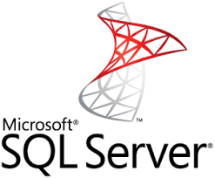
SQL SERVER
•: the database has a free edition for developers and small businesses but only supports 1 processor, 1GB of maximum memory used by the database engine and 10GB maximum database size.
SQL Server is a commercial solution. It’s preferred by companies who are dealing with large traffic
workloads on a regular basis. It’s also considered to be one of the most compatible systems with
Windows services.
The SQL Server infrastructure includes a lot of additional tools, like reporting services, integration
systems, and analytics. For companies that manage multiple teams, these tools make a big difference
in day-to-day work.
Price: The database has a free edition for developers and small businesses but only supports 1 processor, 1GB of maximum memory used by the database engine and 10GB maximum
database size.
SQL Server, also known as Microsoft SQL Server, has been around much longer
than MySQL.

Slide 9
Microsoft developed SQL Server in the 1980s with the promise of providing a reliable and
scalable RDBMS. These remain the core qualities of SQL Server after all these years,
as it is the ideal platform for large-scale enterprise software.
SQL Server is primarily intended for developers who use .NET as a development language
in contrast to PHP for MySQL.
SQL Server is a relational database management and analysis system by Microsoft Targeting the enterprise-level database market
Database Engine is the core service for storing, processing and securing data.
Analysis Services (SSAS) Multidimensional Data supports OLAP by allowing you to
design, create, and manage multidimensional structures. Data Mining enables you to
design, create, and visualize data mining models.

Slide 10
Integration Services (SSIS) is a platform for building high performance data integration
solutions, including ETL processing for data warehousing.
The SQL Server infrastructure includes a lot of additional tools, like reporting services, integration
systems, and analytics. For companies that manage multiple teams, these tools make a big difference
in day-to-day work.

Slide 11
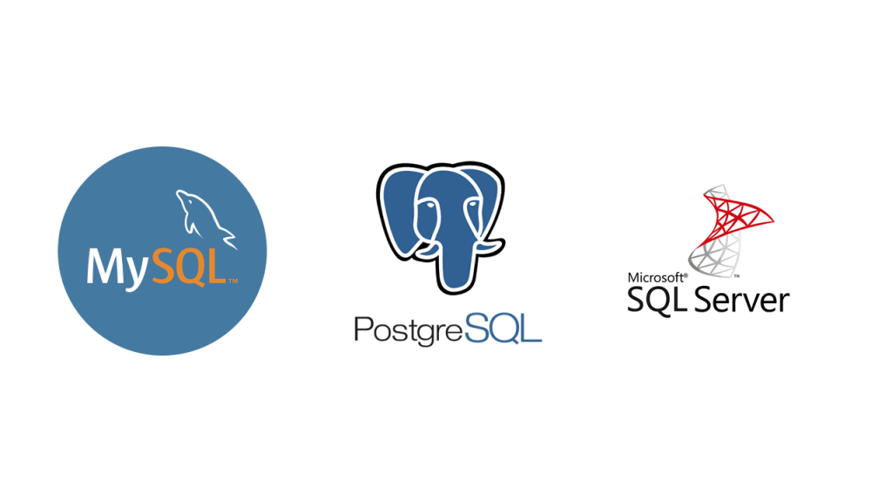
System Properties Comparison
SQL Server vs. MySql vs. PostgreSQL

Slide 12
There are actually a lot of differences between these three software platforms. The more in-depth you go with each one, the more will see the differences.
But the good news is that they are all based on the ANSI SQL Standard. What this really means is that the key functionality that you need to know will remain more or less the same between each one of these databases. Most of the time if you do run into a difference, it’s very easy to research and determine how to modify your SQL commands to work with another database platform.
It does become more challenging if you have built a large application using one database platform and then decide to move it to another one. The commands for creating more advanced functionality like stored procedures or user defined functions might differ. The built-in functions might also be different from one database platform to another.

Slide 13
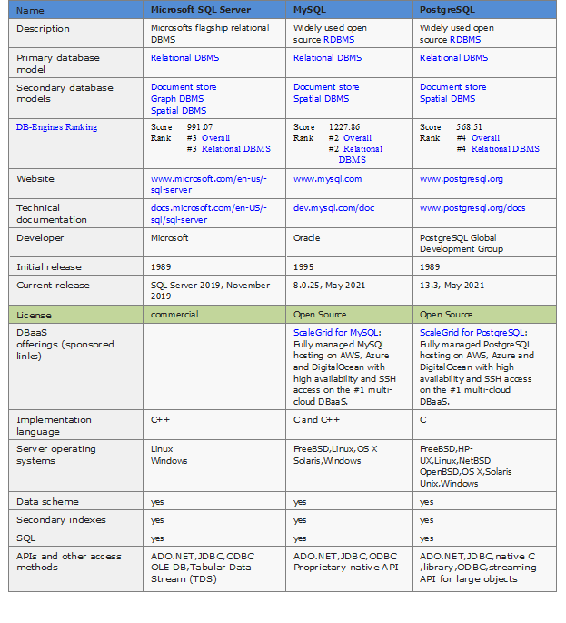

Slide 14
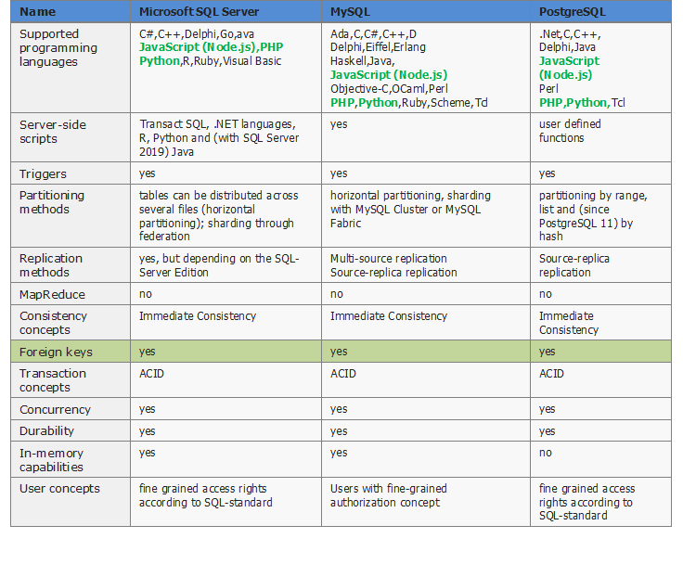

Slide 15
Conclusion
One RDBMS does not have to be better than the other.
It depends on the requirements of the programmer to design his web application.

